Slide 1
Introduction to AnyLogic Building Your First Model
Mohammad Ramshani
University of Tennessee

Slide 2
What We’ll Do ...
Install AnyLogic
Go over the software (briefly)
Introduce different components of the software
Make a simple model

Slide 3
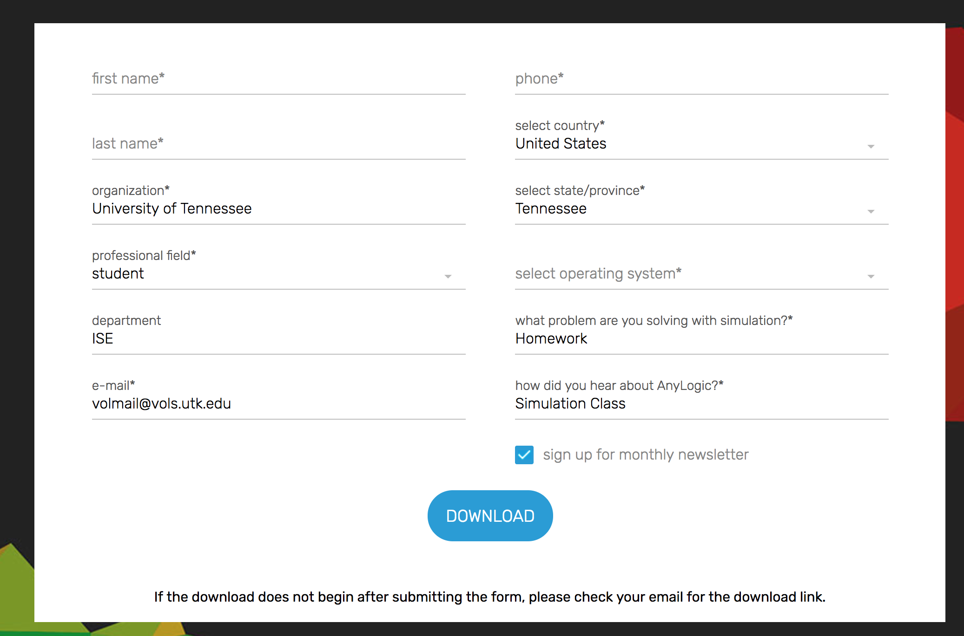
How to Install AnyLogic?
Google Download AnyLogic PLE
Choose AnyLogic PLE (Personal Learning Edition)

Slide 4
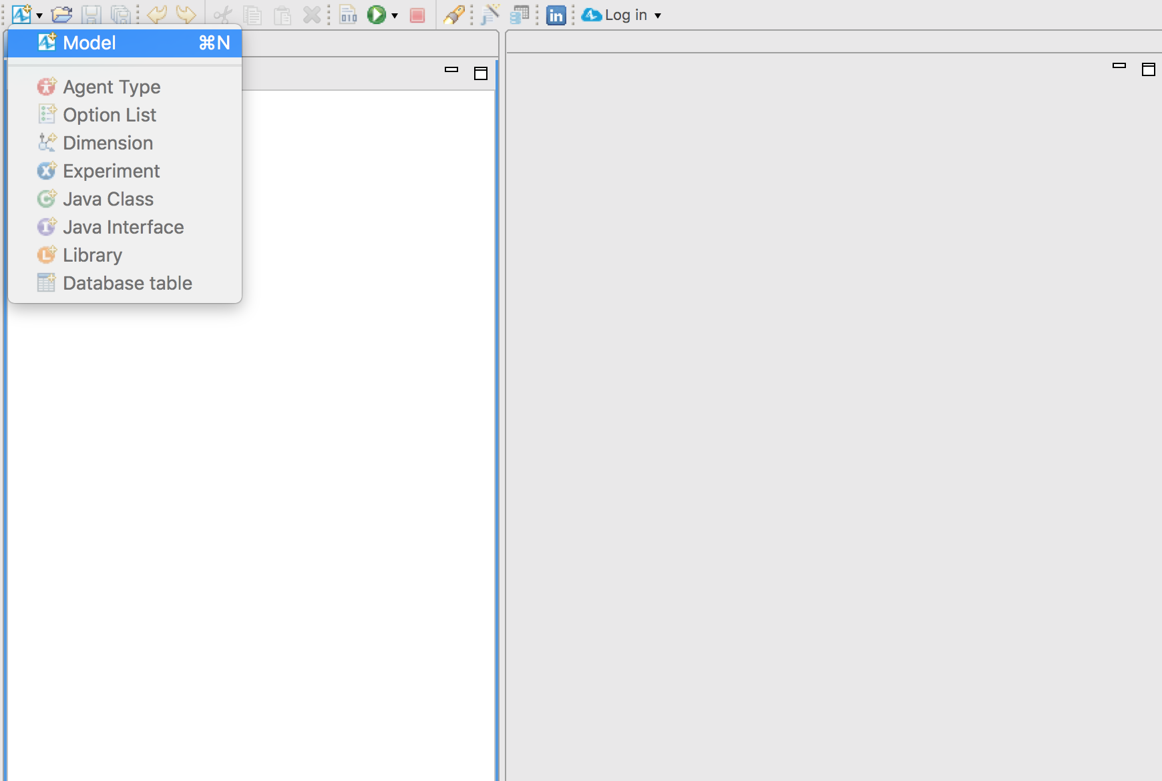
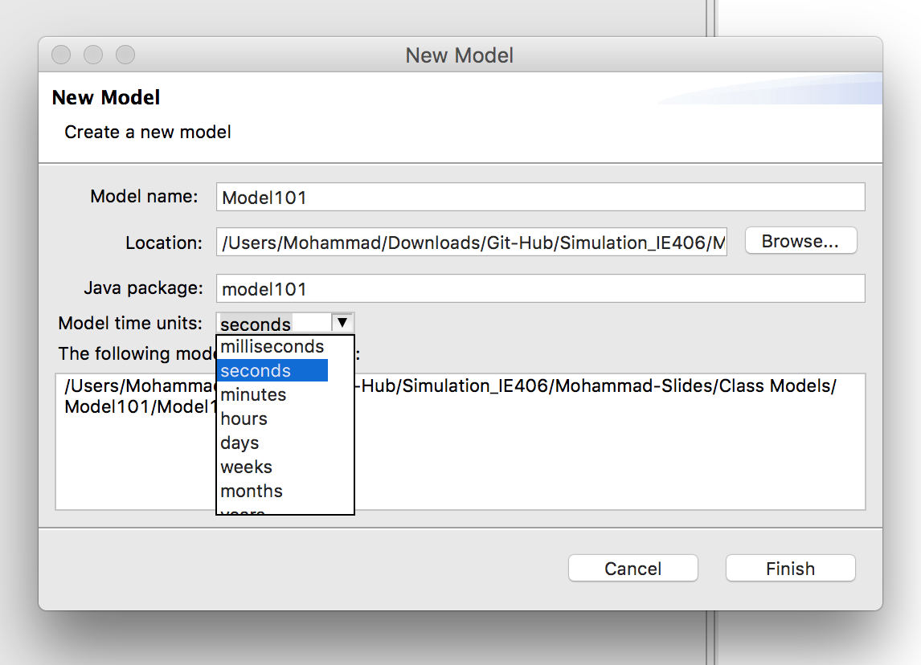
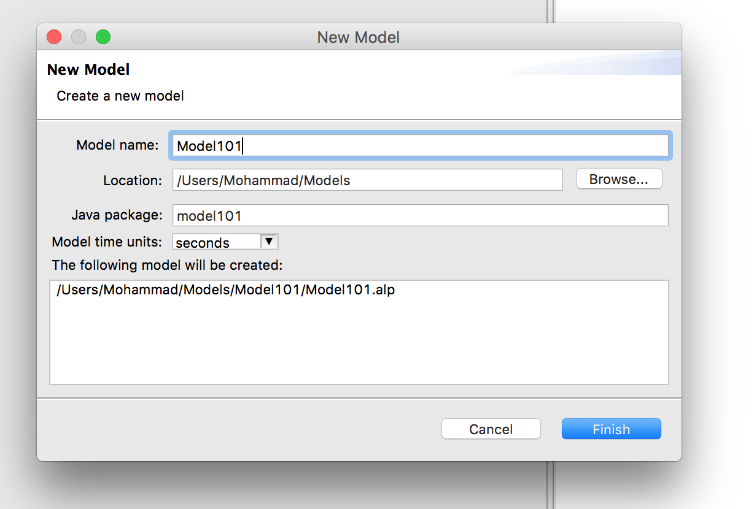
AnyLogic 101
Create a new model

Slide 5
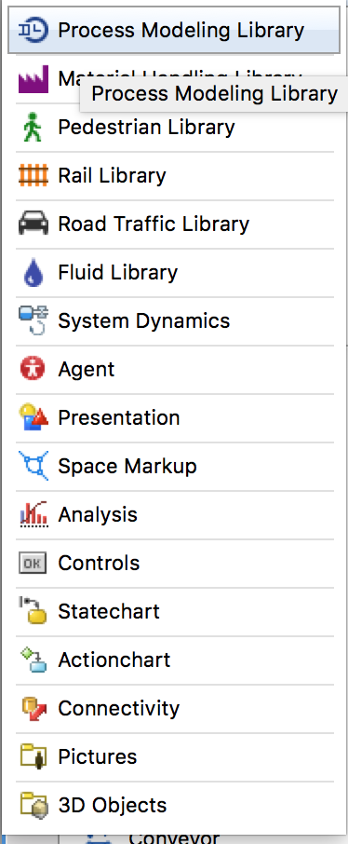
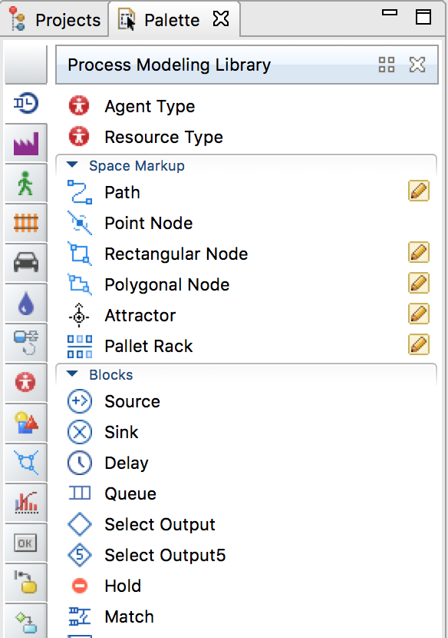
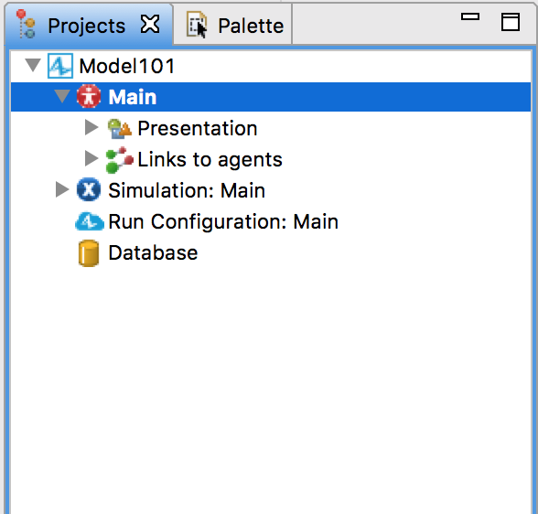
AnyLogic 101
Projects view
Palette view

Slide 6
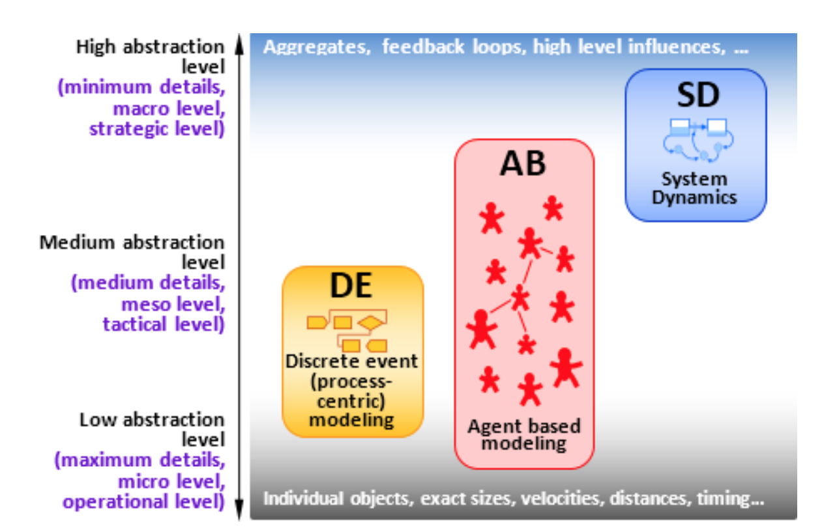
Scope the Problem!
Ask the right question
Understand the processes
Understand the level of granularity you need to work on

Slide 7
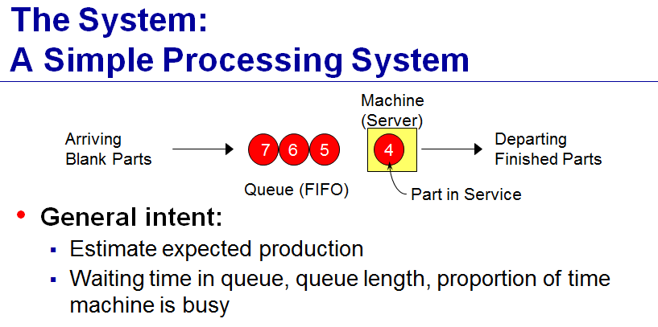
Case Study

Slide 8
Scope the Problem!
Start
Queue
Service
(delay)
End

Slide 9
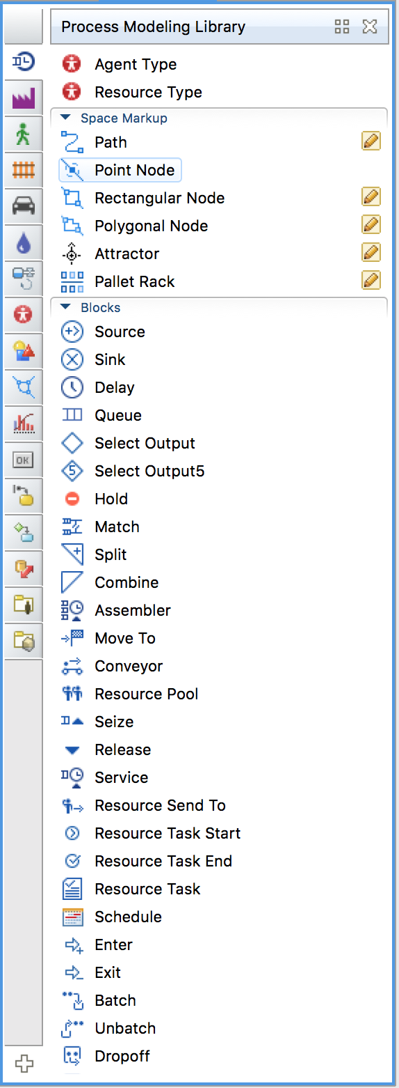
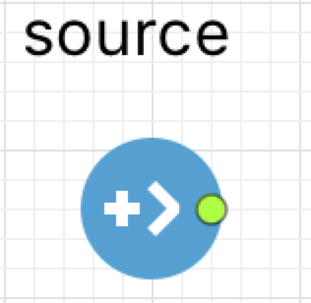
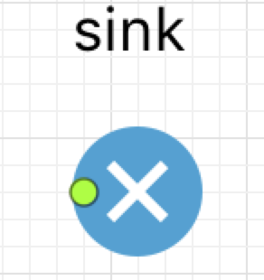
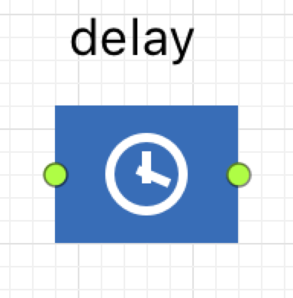
Modules/Toolboxes to learn
Process Modeling Library
Source (start)
Sink (Finish)
Delay (Service)
Queue
Connect them
Place them close
Double click on the green node

Slide 10
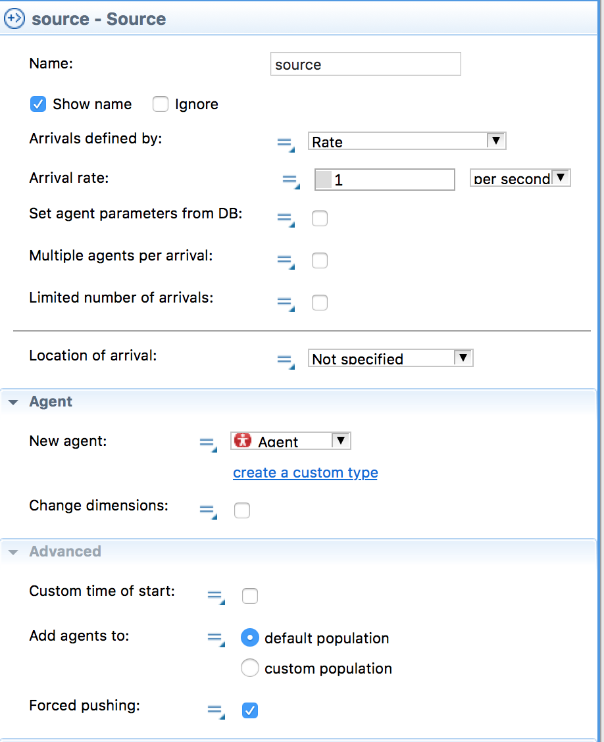
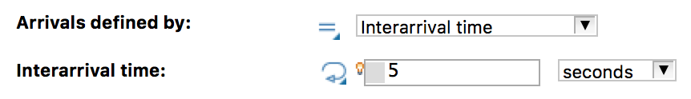
Source
Name
Arrival
Type and Time
Location
Will be covered later
Agent
What we send out!
Example:

Slide 11
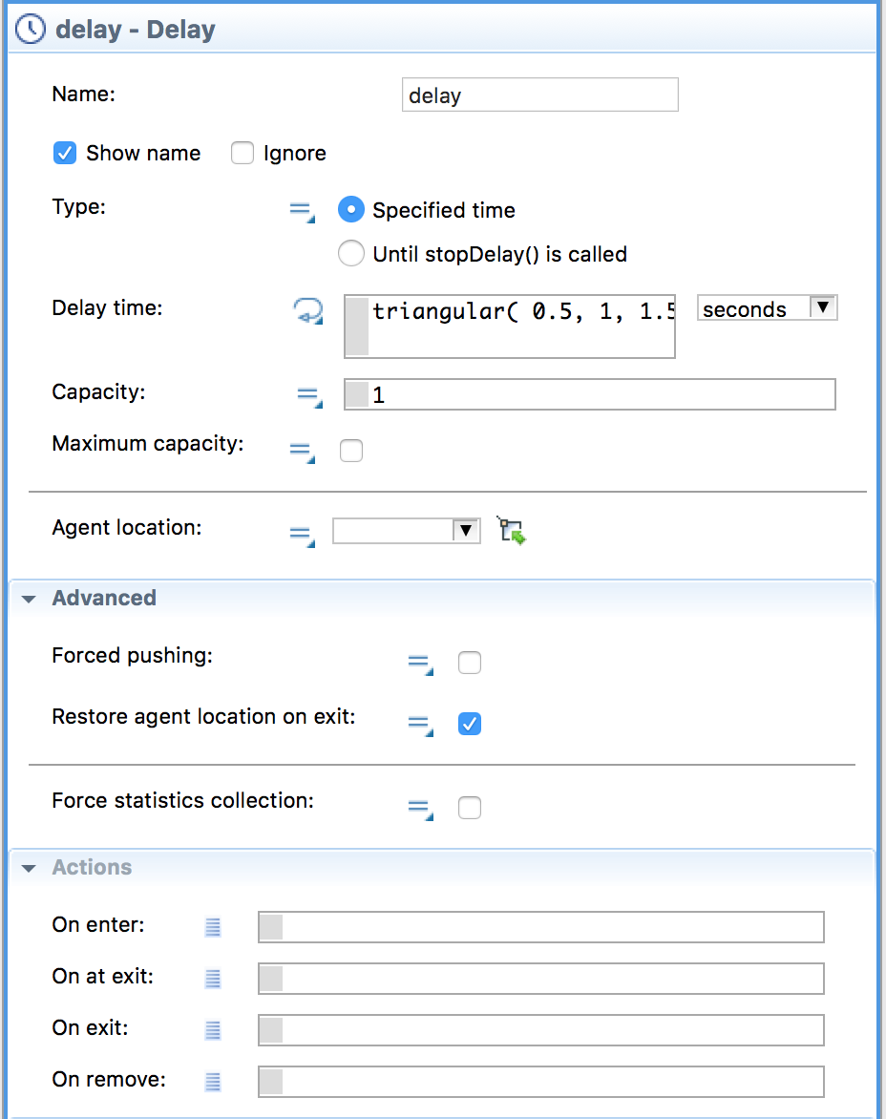
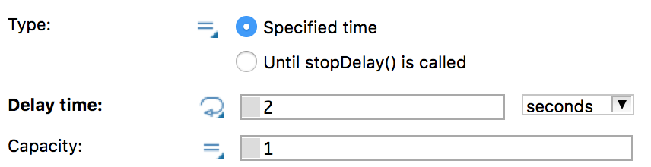
Delay
Name
Type
Delay time
Capacity
Location
Actions
Example:

Slide 12
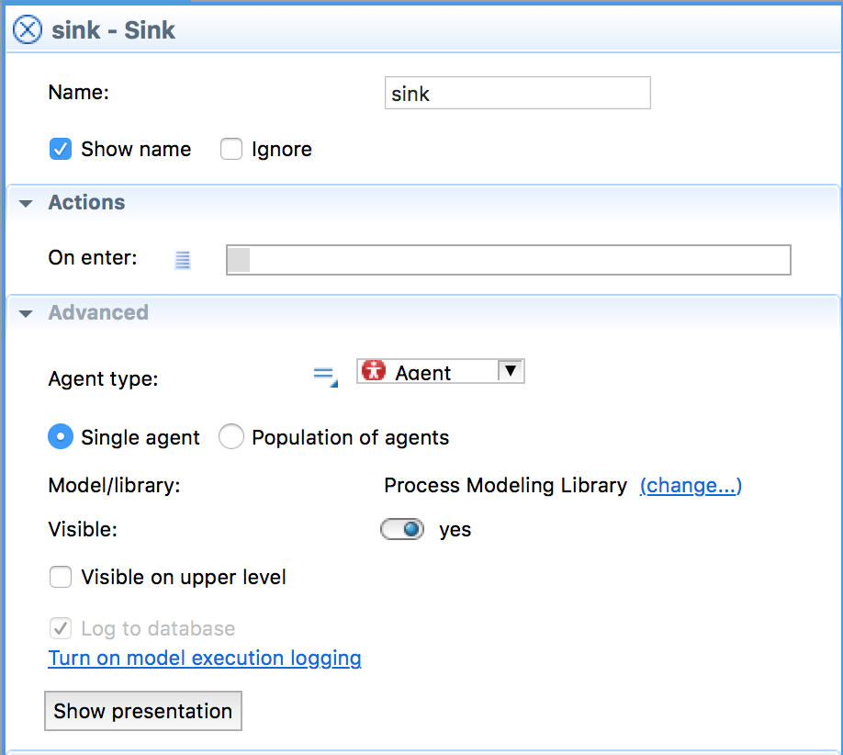
Sink
Name
Actions
Agent Type
Example:
Nothing to do!

Slide 13
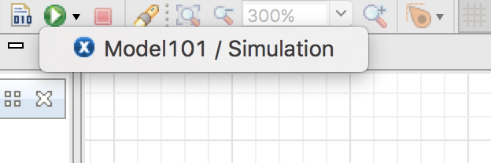
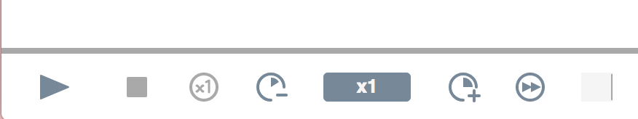
Run the Model!
Green play button
If multiple models click on the arrow to choose from models
Play it
You can adjust the speed

Slide 14
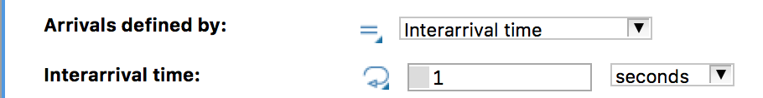
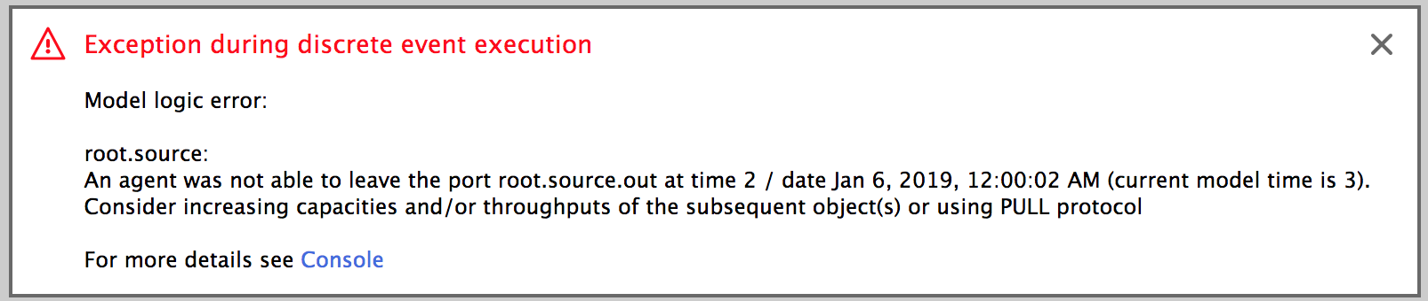
Speed it Up!
Change the interarrival time
Run again

Slide 15
Error!
What is wrong?
How to fix it?
What is missing? (assume fixed capacity)

Slide 16
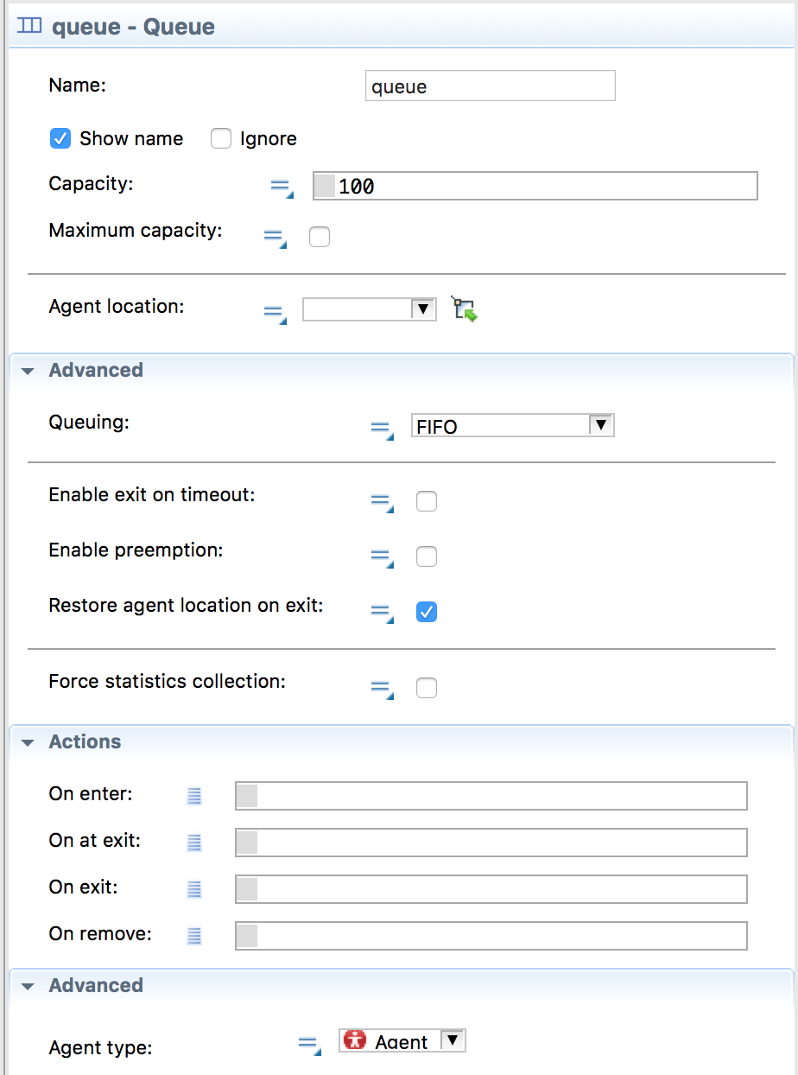
Queue
If service has limited capacity:
Always add Queue before it
Name
Capacity
Make sure it makes sense
Location
Queueing
Actions
Advanced
Run again!!!

Slide 17
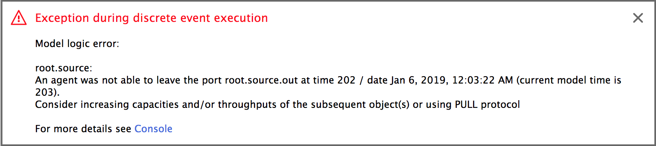
Observe
Discuss what you observe
Speed up the run and wait
Error?

Slide 18
Let’s Make a Model
Source
1 per minute
Queue
No changes
Delay
30 seconds
Run, speed up and check

Slide 19
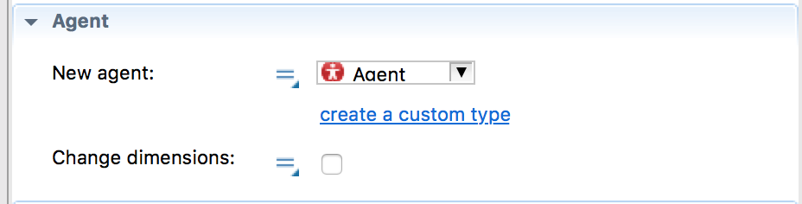
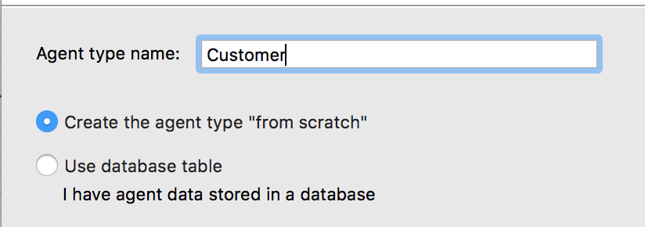
What is Coming Out of Source?
How to define it
Source
Create a custom type
Name (Customer)
Create from scratch

Slide 20
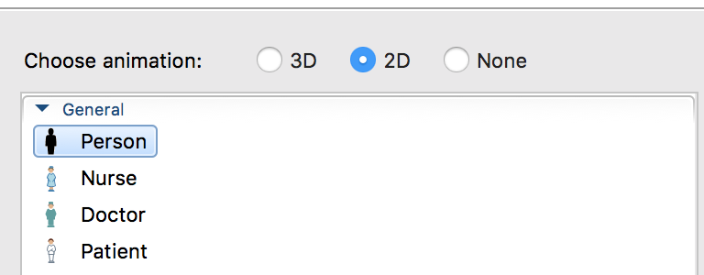
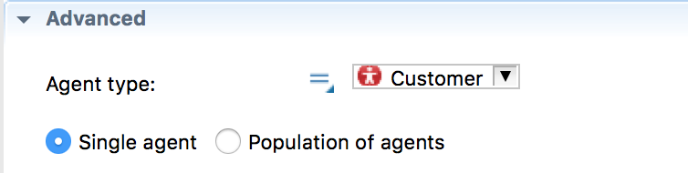
Customize the Agent
Animation
Go over different parts of the simulation
Check advanced and tell us what has changed?

Slide 21
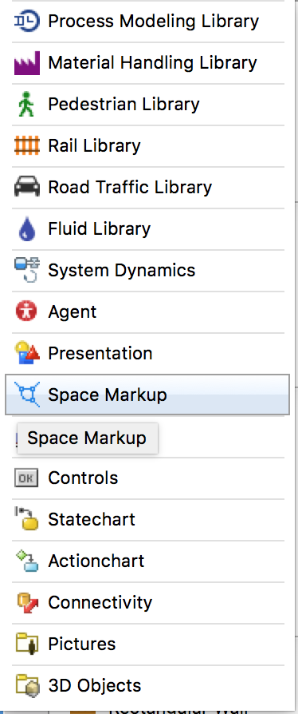
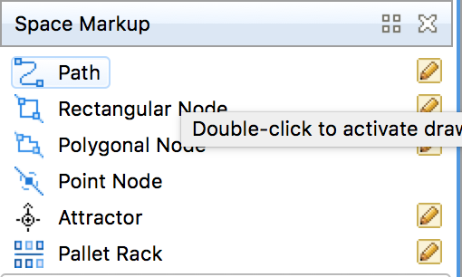
Let’s Work on the Animation
Where to choose a new module library?
Space Markup

Slide 22
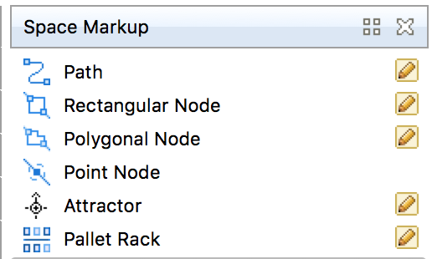
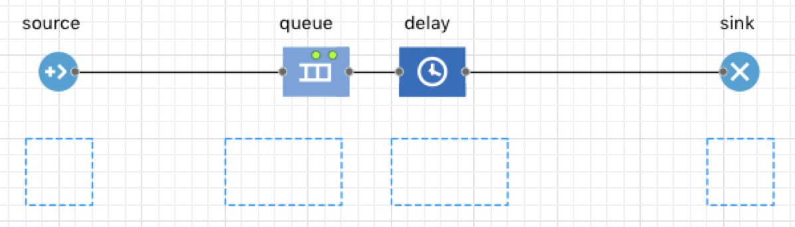
What to Choose?
Something happens to the agent
i.e., Source, Delay, and Queue
Start the animation

Slide 23
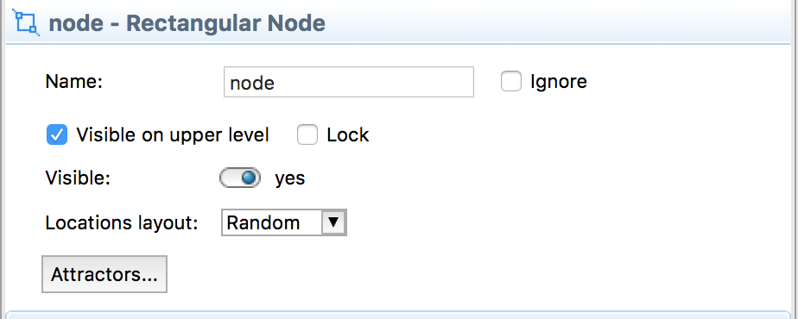
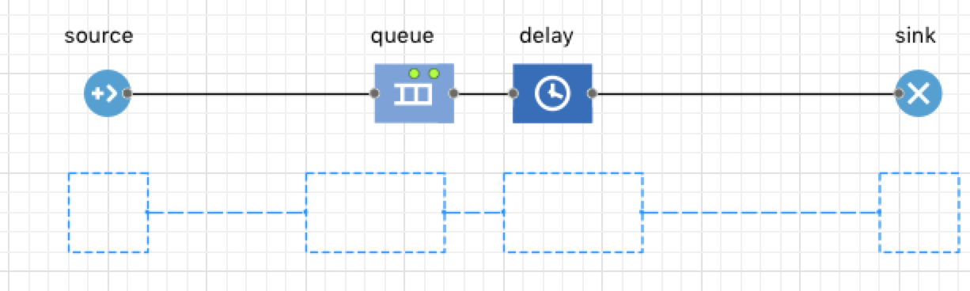
Nodes and Paths
Name the nodes accordingly
Path

Slide 24
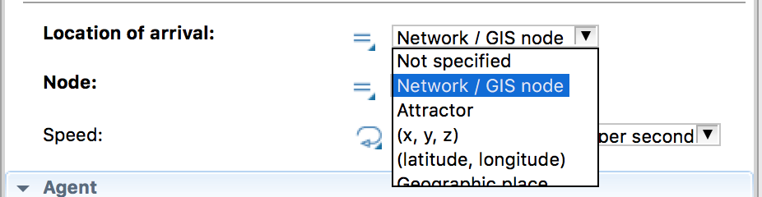
Integrate Model with Animation
Choose node
Location of arrival → Network/GIS node
Link accordingly
What about Sink?
New component for the system to move agents

Slide 25
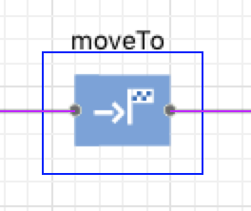
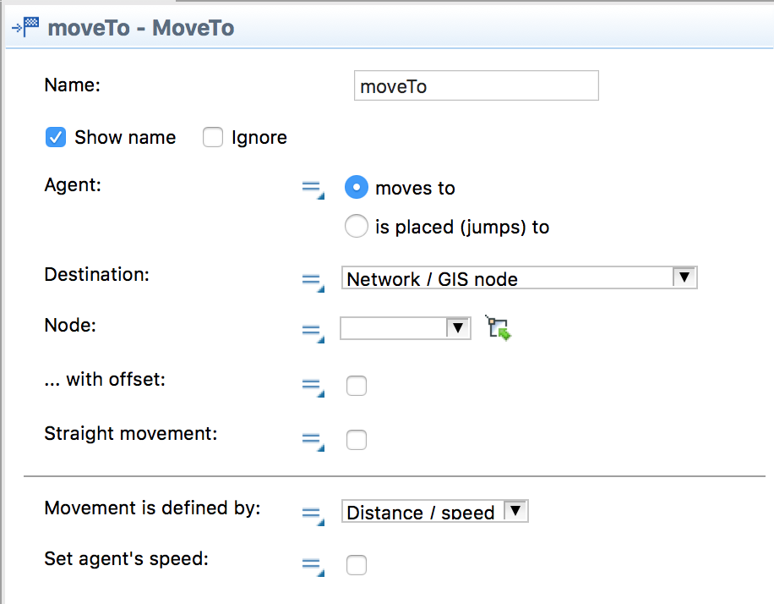
Move to
Which Library?
Config…

Slide 26
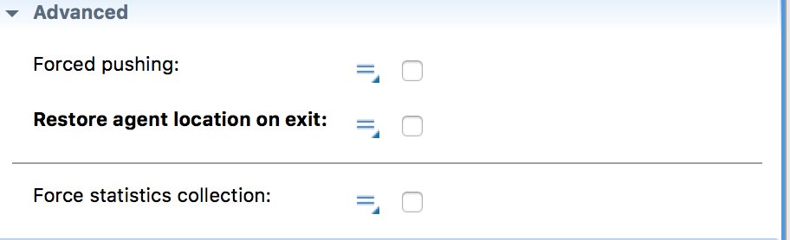
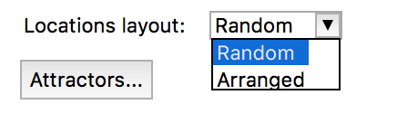
Run Again
Notice anything odd?
But is everything deterministic?

Slide 27

Simulation: *exists*
Stochasticity:

Slide 28
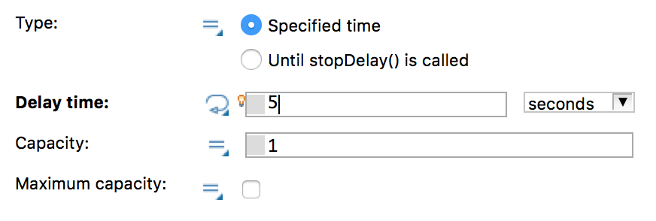
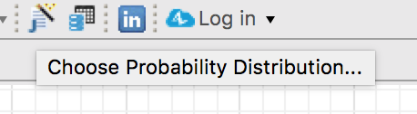
Stochasticity
Use probability distributions
Remove values and replace with distributions

Slide 29
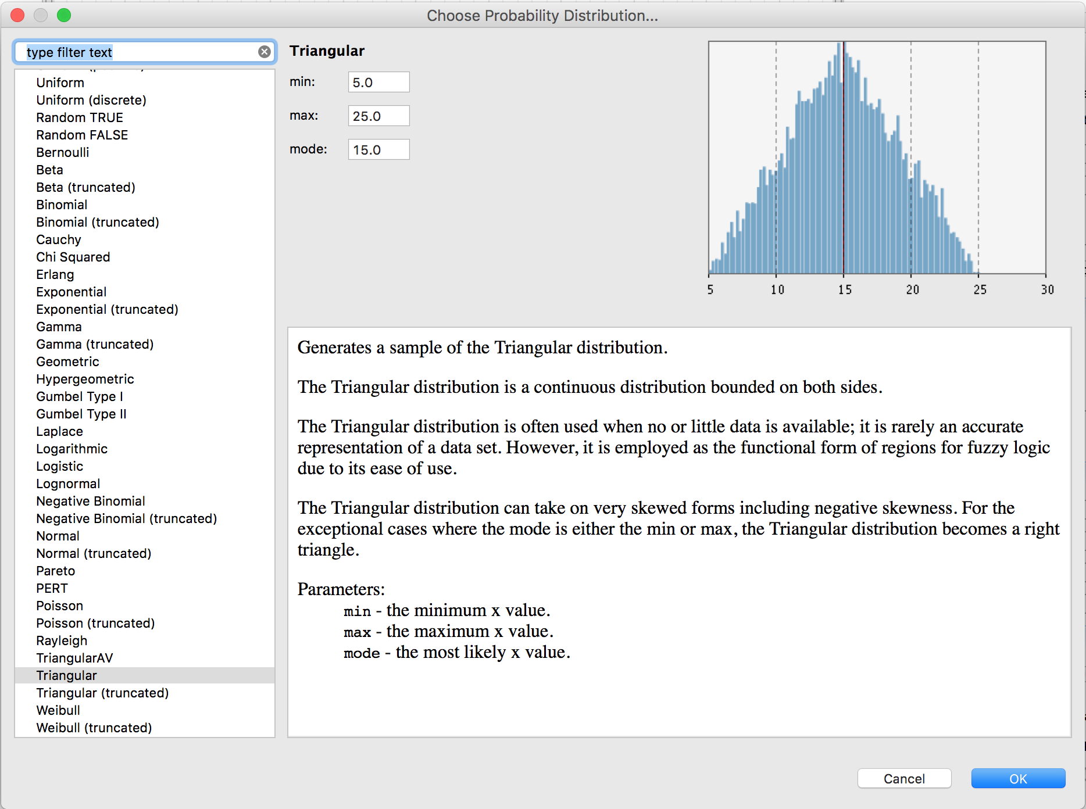

Slide 30
What to Choose?
Based on historical data
If not available
A good estimation (Triangular distribution)

